Slide 1

Introduction to PHP

Slide 2
Objectives
History of PHP
Characteristics of PHP
Variables in PHP
Syntax of PHP
Data types in PHP
Conditional statements
If .. Else statement
Switch statement

Slide 3
Introduction to PHP
PHP started out as a small open source project that evolved as more and more people found out how useful it was. Rasmus Lerdorf unleashed the first version of PHP way back in 1994.
PHP is a recursive acronym for "PHP: Hypertext Preprocessor".
PHP is a server side scripting language that is embedded in HTML. It is used to manage dynamic content, databases, session tracking, even build entire e-commerce sites.
It is integrated with a number of popular databases, including MySQL, PostgreSQL, Oracle, Sybase, Informix, and Microsoft SQL Server.
PHP is pleasingly zippy in its execution, especially when compiled as an Apache module on the Unix side. The MySQL server, once started, executes even very complex queries with huge result sets in record-setting time.
PHP Syntax is C-Like.

Slide 4
Common uses of PHP
PHP performs system functions, i.e. from files on a system it can create, open, read, write, and close them.
PHP can handle forms, i.e. gather data from files, save data to a file, through email you can send data, return data to the user.
You add, delete, modify elements within your database through PHP.
Access cookies variables and set cookies.
Using PHP, you can restrict users to access some pages of your website.
It can encrypt data.

Slide 5
Characteristics of PHP
Open source, free to download and use
Cross platform
Compatible with any server
Supports popular databases
Easy to learn

Slide 6
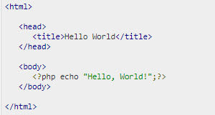
"Hello World" Script in PHP
Example
Output:

Slide 7
Data types supported by PHP
Following data types are supported by PHP:
Integer: It is stored as signed integers with 32 bits, with a range of -2,147,483,648 and 2,147,483,647
Float: It is stored as IEEE floating point number with 64 bits.
String: It is a sequence of 8-bit characters.
Boolean: It has two literal values: 'true' and 'false'
Array: It store an ordered map of pairs of keys and values.
Object: It stores an instance of class.
Resource: It is for storing file handling, or database connection.
Null: It has only value null.

Slide 8

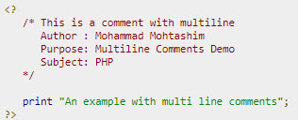
Commenting PHP Code
A comment is the portion of a program that exists only for the human reader and stripped out before displaying the programs result. There are two commenting formats in PHP
Single-line comments − They are generally used for short explanations or notes relevant to the local code.
Multi-lines comments − They are generally used to provide pseudocode algorithms and more detailed explanations when necessary. The multiline style of commenting is the same as in C.

Slide 9
Syntax of PHP
Every code in PHP starts with <?php and ends with ?>
PHP is whitespace insensitive
PHP is case sensitive
Statements are expressions terminated by semicolons (;)
The PHP echo statement is often used to output data to the screen.
PHP is a Loosely Typed Language.
PHP automatically converts the variable to the correct data type, depending on its value.

Slide 10
PHP variables
In PHP, a variable starts with the $ sign, followed by the name of the variable.
When you assign a text value to a variable, put quotes around the value.
PHP variable names are case-sensitive.
In PHP, variables can be declared anywhere in the script.
The scope of a variable is the part of the script where the variable can be referenced/used.

Slide 11
PHP variables
Rules for PHP variables:
A variable starts with the $ sign, followed by the name of the variable
A variable name must start with a letter or the underscore character
A variable name cannot start with a number
A variable name can only contain alpha-numeric characters and underscores (A-z, 0-9, and _ )
Variable names are case-sensitive ($age and $AGE are two different variables)

Slide 12
PHP constants
A constant is a name or an identifier for a simple value.
A constant value cannot change during the execution of the script. By default, a constant is case-sensitive.
By convention, constant identifiers are always uppercase.
A constant name starts with a letter or underscore, followed by any number of letters, numbers, or underscores. If you have defined a constant, it can never be changed or undefined.
To define a constant you have to use define() function and to retrieve the value of a constant, you have to simply specifying its name. Unlike with variables, you do not need to have a constant with a $.

Slide 13
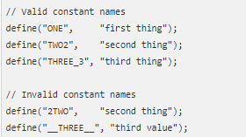
PHP constants
Differences between constants and variables:
There is no need to write a dollar sign ($) before a constant, where as in Variable one has to write a dollar sign.
Constants cannot be defined by simple assignment, they may only be defined using the define() function.
Constants may be defined and accessed anywhere without regard to variable scoping rules.
Once the Constants have been set, may not be redefined or undefined.

Slide 14
Demo
Teacher demo code about variable and creating PHP file.

Slide 15
Conditional Statements
Very often when you write code, you want to perform different actions for different conditions. You can use conditional statements in your code to do this.
In PHP we have the following conditional statements:
if statement - executes some code if one condition is true
if...else statement - executes some code if a condition is true and another code if that condition is false
if...elseif....else statement - executes different codes for more than two conditions
switch statement - selects one of many blocks of code to be executed

Slide 16
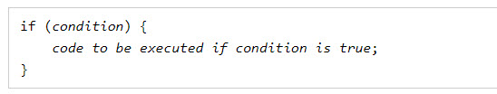
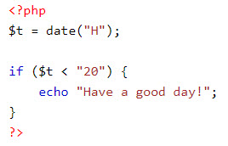
If statement
The if statement executes some code if one condition is true.
Example:

Slide 17
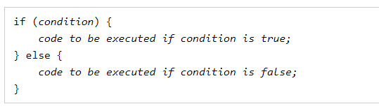
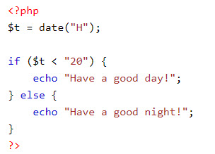
If … else statement
The if....else statement executes some code if a condition is true and another code if that condition is false.
Example:

Slide 18
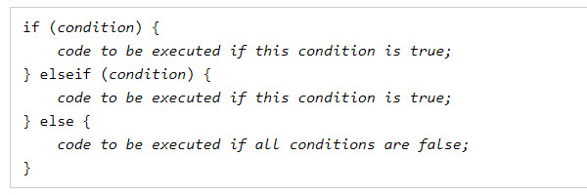
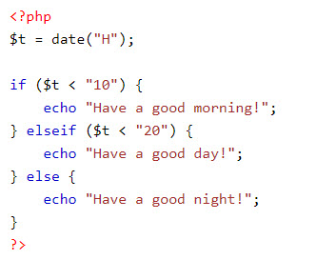
if...elseif....else Statement
The if....elseif...else statement executes different codes for more than two conditions.
Example:

Slide 19
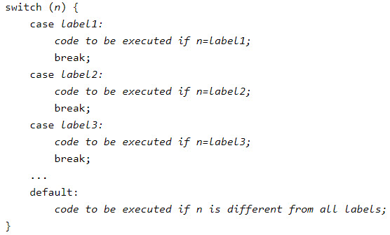
Switch Statement
The switch statement is used to perform different actions based on different conditions.
This is how it works:
First we have a single expression n (most often a variable), that is evaluated once.
The value of the expression is then compared with the values for each case in the structure.
If there is a match, the block of code associated with that case is executed.
Use break to prevent the code from running into the next case automatically.
The default statement is used if no match is found.

Slide 20
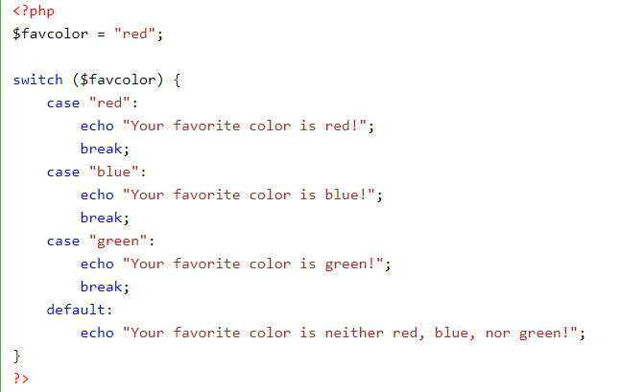
Switch Statement
Example

Slide 21
Demo
Teacher demo code about if..else and switch statements for students

Slide 22
Summary
History of PHP
Characteristics of PHP
Variables in PHP
Syntax of PHP
Data types in PHP
Conditional statements
If .. Else statement
Switch statement

